Slide 1
Virtual Memory Lesson 5 Thrashing and Working Set
David Liu
2021

Slide 2
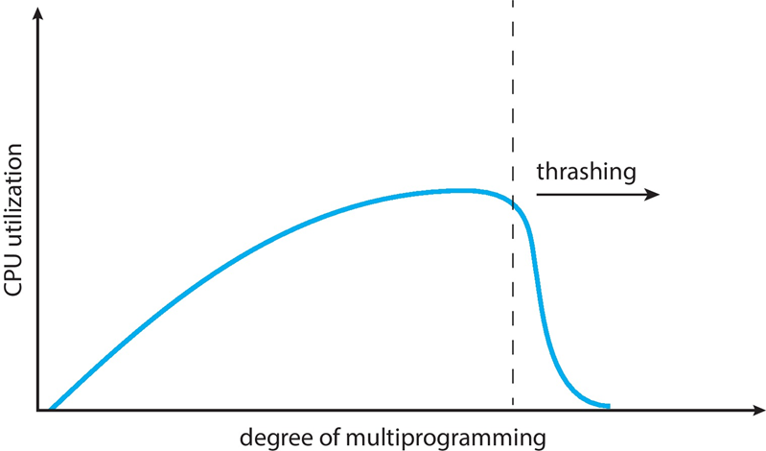
Thrashing
If a process does not have “enough” pages, the page-fault rate is very high
Page fault to get page
Replace existing frame
But quickly need replaced frame back
This leads to:
Low CPU utilization
Operating system thinking that it needs to increase the degree of multiprogramming
Another process added to the system
Thrashing.
A process is busy swapping pages in and out

Slide 3
Demand Paging and Thrashing
Why does demand paging work? Locality model
Process migrates from one locality to another
Localities may overlap
Why does thrashing occur? Σ size of locality > total memory size
Limit effects by using local or priority page replacement

Slide 4
Locality In A Memory- Reference Pattern

Slide 5
Working-Set Model
Δ ≡ working-set window ≡ a fixed number of page references Example: 10,000 instructions
WSS_{i} (working set of Process P_{i}) = total number of pages referenced in the most recent Δ (varies in time)
if Δ too small will not encompass entire locality
if Δ too large will encompass several localities
if Δ = ∞ ⇒ will encompass entire program
D = Σ WSS_{i} ≡ total demand frames
Approximation of locality

Slide 6
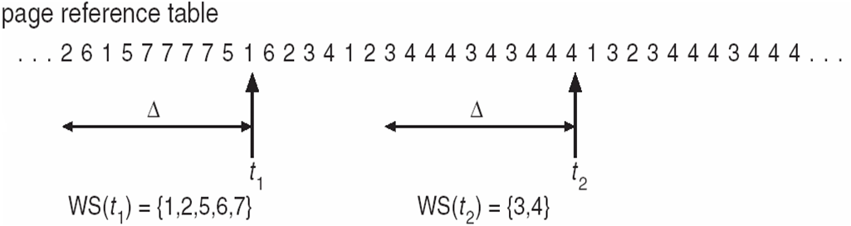
Working-Set Model (Cont.)
if D > m ⇒ Thrashing
Policy if D > m, then suspend or swap out one of the processes

Slide 7
Keeping Track of the Working Set
Approximate with interval timer + a reference bit
Example: Δ = 10,000
Timer interrupts after every 5000 time units
Keep in memory 2 bits for each page
Whenever a timer interrupts copy and sets the values of all reference bits to 0
If one of the bits in memory = 1 ⇒ page in working set
Why is this not completely accurate?
Improvement = 10 bits and interrupt every 1000 time units

Slide 8
Page-Fault Frequency
More direct approach than WSS
Establish “acceptable” page-fault frequency (PFF) rate and use local replacement policy
If actual rate too low, process loses frame
If actual rate too high, process gains frame

Slide 9
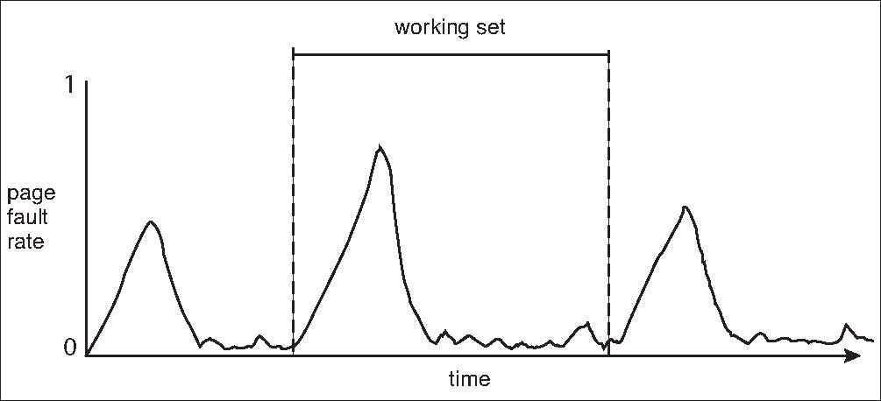
Working Sets and Page Fault Rates
Direct relationship between working set of a process and its page-fault rate
Working set changes over time
Peaks and valleys over time

